Slide 1

SINGAPORE CRIME Analysis
Capstone Project 2

Slide 2
Problem Statements
Singapore is one of the safest countries in the world. Overall crime rate in Singapore is low. Majority of general public felt safe walking home alone in their neighborhood at night.
However, do we really know in more on the crime trend in Singapore?
Is there an increase in the overall crime rate over the years?
What is the most common type of crime?
Is crime cases vary greatly by neighborhood?
What is the offences that seeing increases in recent year and is a concern?
Who are more vulnerable to the crime of concern?
Knowing the crime trend well for both general public and Singapore Police Force are important. This increases the awareness of general public and community involvement in fighting against crime is an essential pillar to keep Singapore safe and secure.

Slide 3
Data collection from various sources
Source 1: data.gov.sg (MHA – Singapore Police Force, Ministry of Trade and Industry – Department of Statistics)
Overall Crime Cases recorded by crime classification
Five Preventable Crime Cases Recorded by NPC
Unlicensed Moneylending (UML) and Harassment by NPC
Person Arrested for Selected Major Offences
Singapore Residents, Annual
Source 2: Department of Statistics Singapore
Victims of Selected Major Offences by Sex and Broad age group, annual
Notes:
Figures are based on annual statistical reports on Crime in Singapore

Slide 4

Design of database schema 1. Entity – Relationship Diagram 2. Relational Schemas

Slide 5
Entity Relationship Diagram
Entities:
- Crime incidents
- Crime type
- Police station
- Arrested
- Victims
- Population

Slide 6
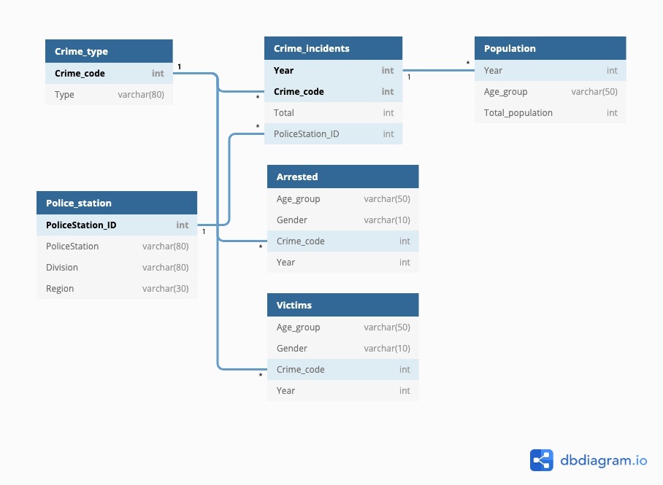
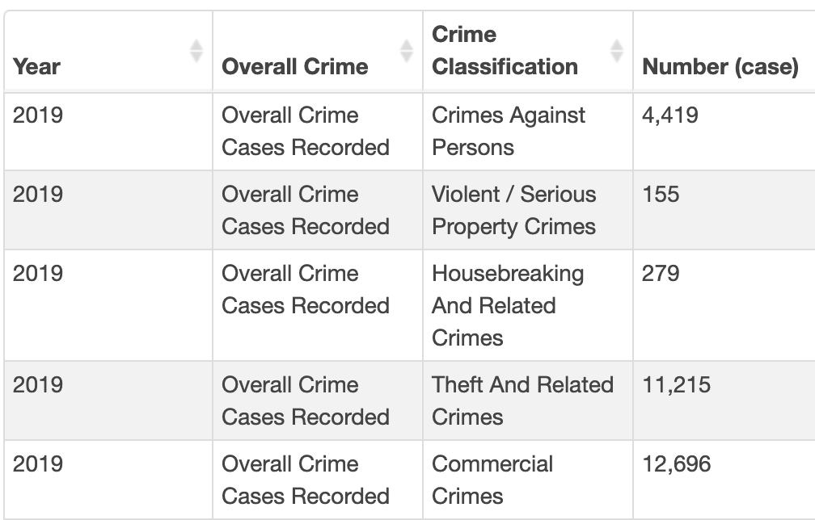
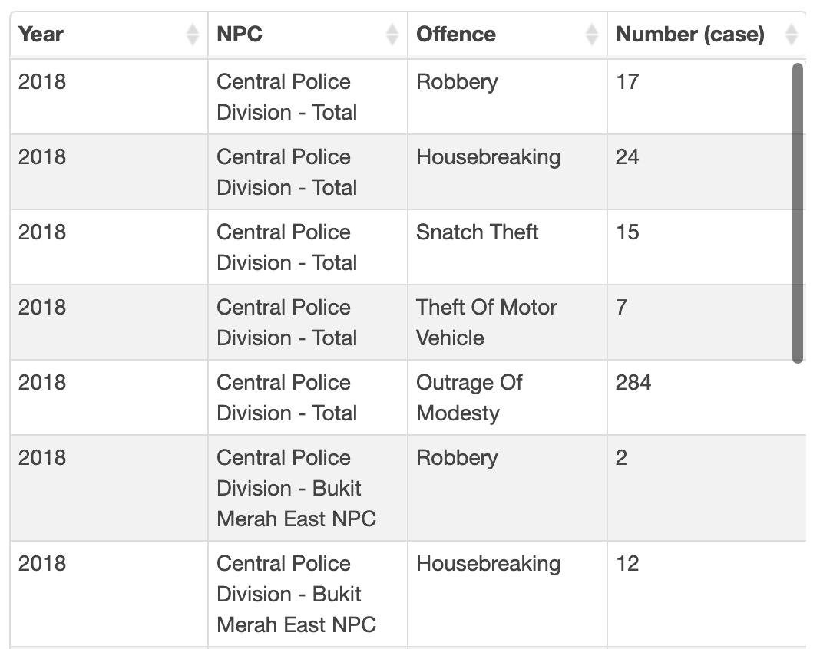
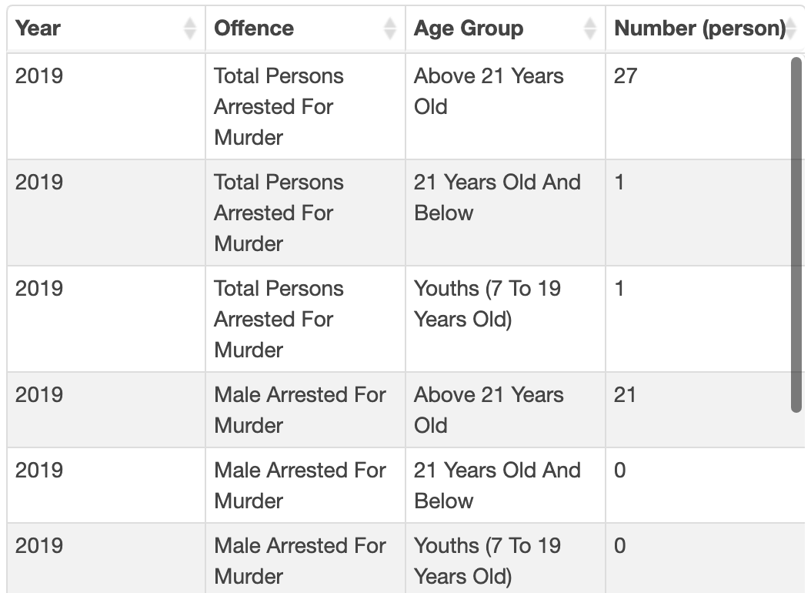
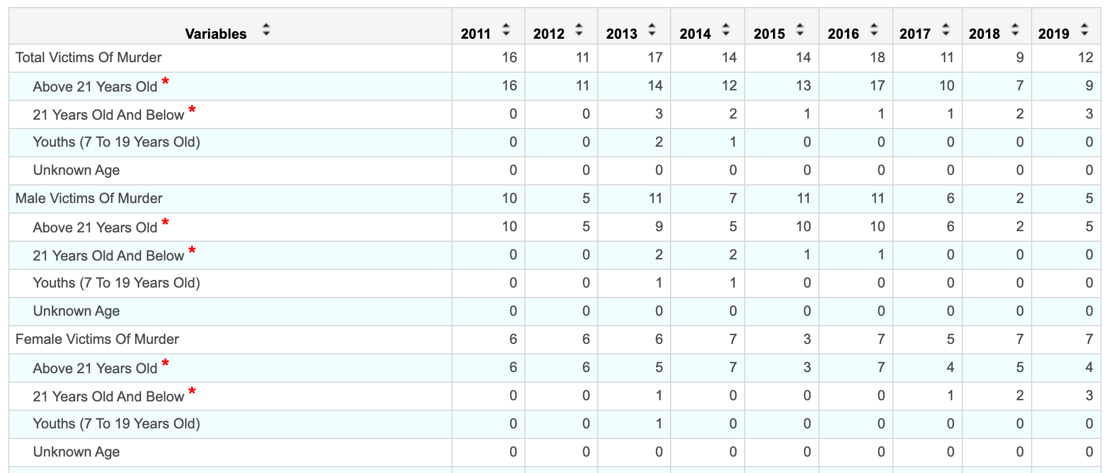
Relational Schemas
Overall crime cases recorded by crime classification
Five preventable crimes by NPC
Person arrested for selected major offences
Singapore residents, annual

Slide 7
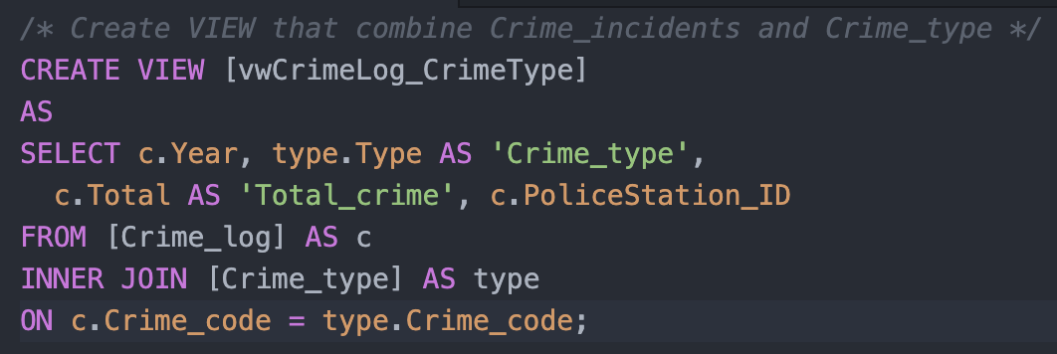
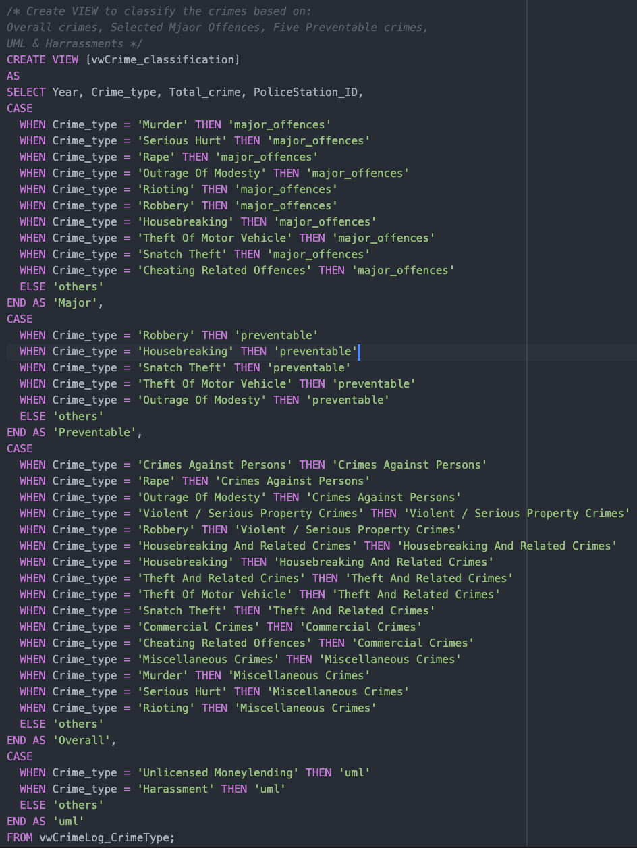
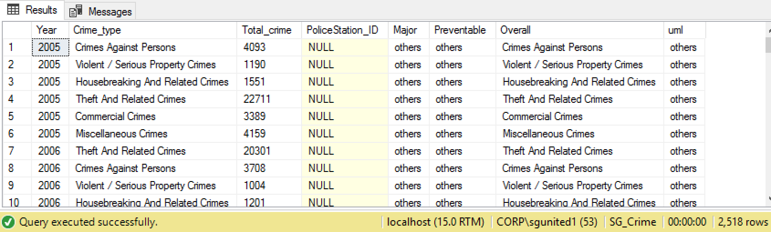
Data Analysis using SQL - Is there an increase in the overall crime rate over the years? - Is crime rate vary greatly by neighborhood?

Slide 8
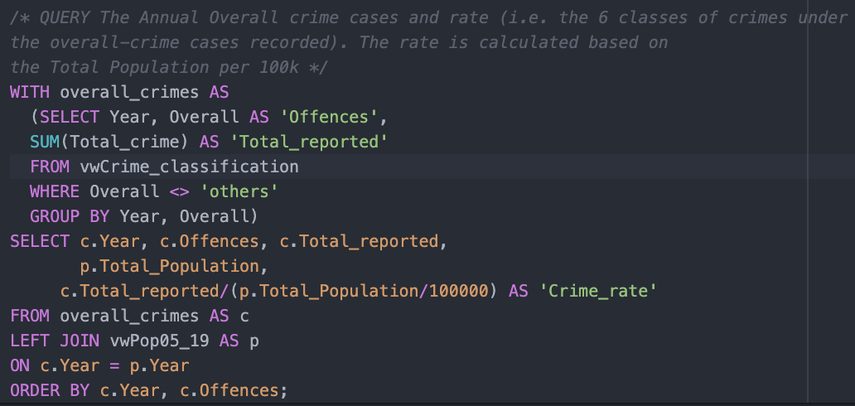
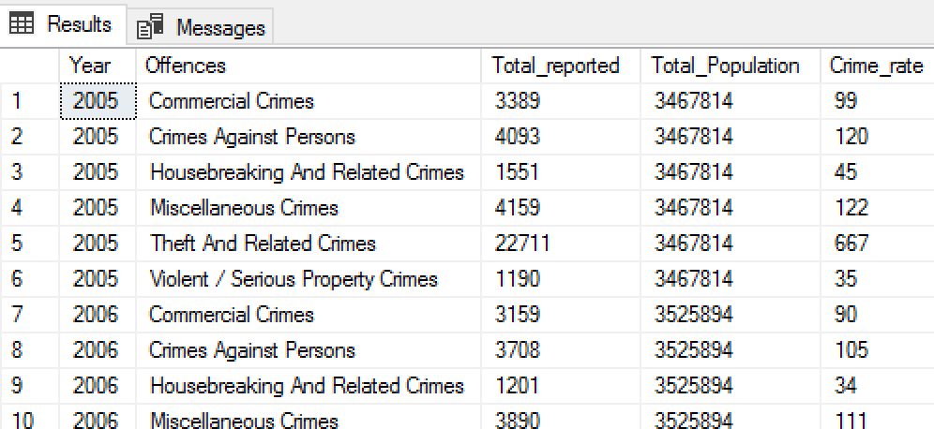
Data Analysis using SQL - Is there an increase in the overall crime rate over the years?

Slide 9
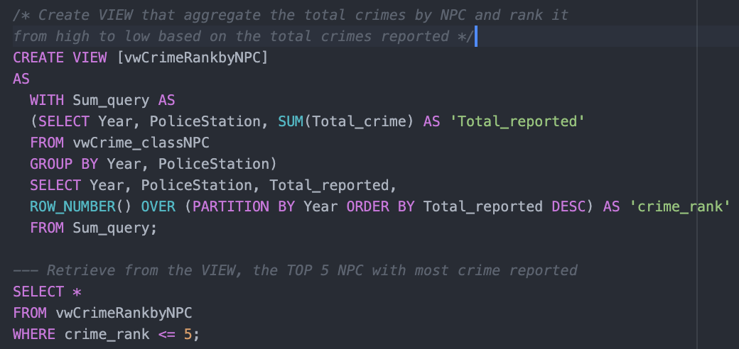
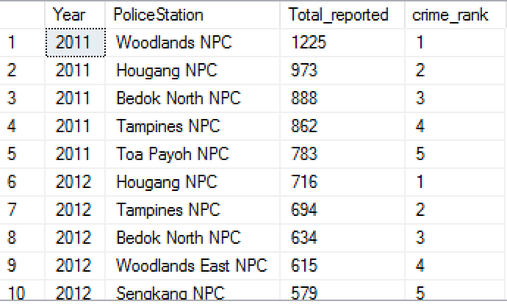
Data Analysis using SQL - Is crime rate vary greatly by neighborhood?

Slide 10
Insights: Overall Crime
Dashboard 1: Overall Crime
Overall crime rate increase slightly since year 2018.
The increase in the number of reported crime was primarily due to a significant increase in Commercial Crimes.
Four out of six crime classes that made up overall crime in 2019 decreased compared to 2018.

Slide 11
Insights: Crimes (5 Preventable crime, Unlicensed Money Lending and Harassment) reported by NPC
Dashboard 2: Five Preventable Crime, Unlicensed Money Lending and Harassment by Neighborhood Police Center (NPC)
Overall crime for these TWO classes increases in year 2017, 2018.
The increase in the number of reported crime were due to increases in UML-related harassment, and Outrage of Modesty.
UML – related harassment cases increased by 14.6% to 5278 cases in 2019, from 4607 cases in 2018.
Outrage of Modesty cases increased by 10.6% to 1708 cases in 2018, from 1543 cases in 2017. Although annual crime brief 2019 from Police news release that, cases decreased by 7.1% to 1605 it remains a cause of concern due to the high number of reported cases.
Robbery, Theft of Motor Vehicles are in downward trend.

Slide 12
Insights: Person Arrested and Victims by Selected Major Offences
Dashboard 3: Person Arrested and Victims by Selected Major Offences
Overall person arrested in year 2019 is slightly reduced (-4.5%).
Majority of person arrested is from Male (82%) , age-group of above 21 years old.
TOP Two offences with the greatest number of person arrested are Cheating related offences and outrage of modesty.
Majority of person arrested from Rioting is from younger age-group (21 years old and below).
Overall reported victims increased in year 2019 by 30%.
On average in 9 years (2011-2019), 53% victims are female. However, in year 2019, 51% victims are male.
Among the TOP offences with greatest number of victims, male made up of 59%.
Female continue to be more vulnerable to offence of Outrage of Modesty (on average of of 92% in 9 years). However, male victims observed an increased in year 2019, from 7% in year 2018 to 12% in year 2019.
Young people and youth are more vulnerable to offences of Rape.

Slide 13





Summary
Crime rate though remain low, but increased in two consecutive years, 2018, and 2019.
Most common types of crime is Commercial Crimes
Total crime cases reported vary by NPC.
Increase in outrage of modesty cases trend remain a concern.
Male is more vulnerable to Cheating related Offences, but Female is more impacted in Outrage of Modesty

